Slide 1
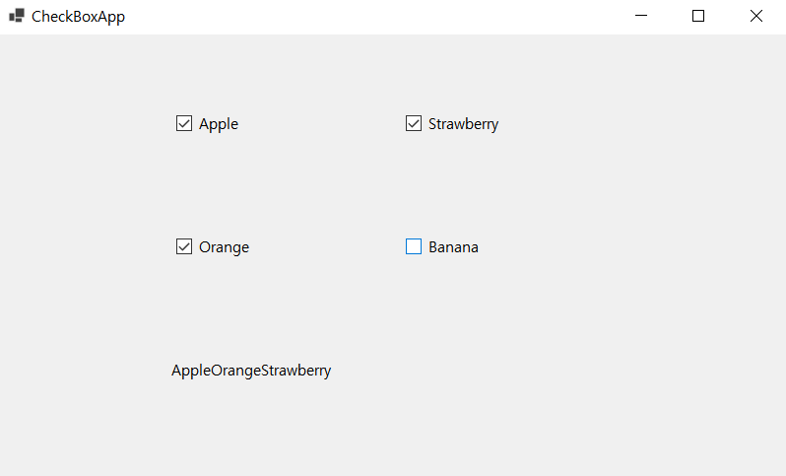
using System;
using System.Windows.Forms;
namespace CheckBoxSample
{
public partial class Form1 : Form
{
public Form1()
{
InitializeComponent();
}
private void UpdateLabel(string s, bool b)
{
if (b)
{
label1.Text += s; // label1의 Text 프로퍼티에 문자열 추가
}
else
{
string strTemp = label1.Text;
int i = strTemp.IndexOf(s);
label1.Text = strTemp.Remove(i, s.Length);
}
}
private void checkBox1_CheckedChanged(object sender, EventArgs e)
{
UpdateLabel(checkBox1.Text, checkBox1.Checked);
}
private void checkBox2_CheckedChanged(object sender, EventArgs e)
{
UpdateLabel(checkBox2.Text, checkBox2.Checked);
}
private void checkBox3_CheckedChanged(object sender, EventArgs e)
{
UpdateLabel(checkBox3.Text, checkBox3.Checked);
}
private void checkBox4_CheckedChanged(object sender, EventArgs e)
{
UpdateLabel(checkBox4.Text, checkBox4.Checked);
}
}
}

Slide 2
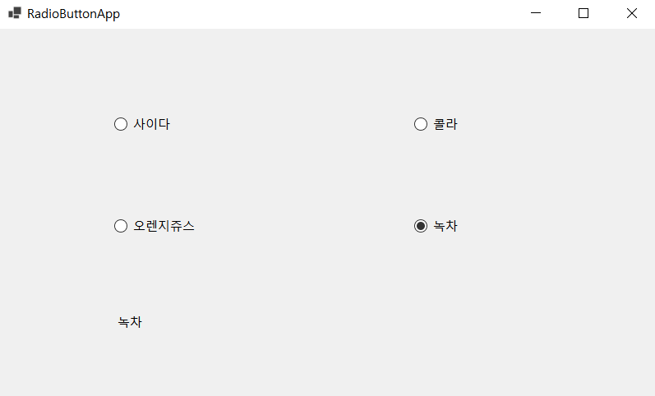
using System;
using System.Windows.Forms;
namespace RadioButtonApp
{
public partial class Form1 : Form
{
public Form1()
{
InitializeComponent();
}
private void radioButton1_CheckedChanged(object sender, EventArgs e)
{
label1.Text = radioButton1.Text;
}
private void radioButton2_CheckedChanged(object sender, EventArgs e)
{
label1.Text = radioButton2.Text;
}
private void radioButton3_CheckedChanged(object sender, EventArgs e)
{
label1.Text = radioButton3.Text;
}
private void radioButton4_CheckedChanged(object sender, EventArgs e)
{
label1.Text = radioButton4.Text;
}
}
}

Slide 3
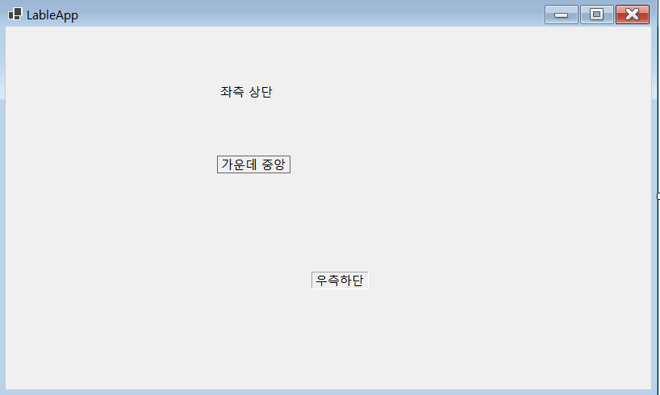
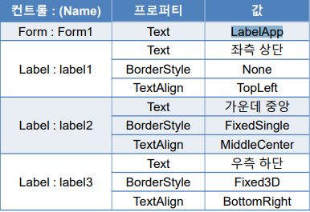

Slide 4
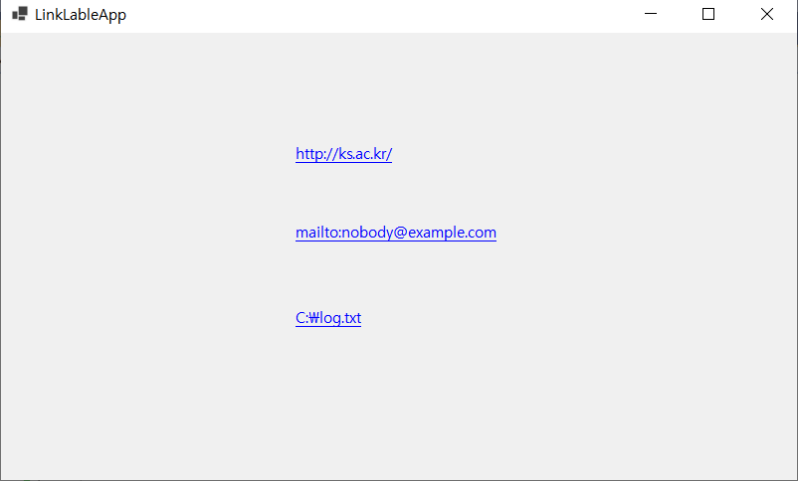
using System;
using System.Diagnostics;
using System.Windows.Forms;
namespace CheckBoxSample
{
public partial class Form1 : Form
{
public Form1()
{
InitializeComponent();
}
private void label1_Click(object sender, EventArgs e)
{
}
private void Form1_Load(object sender, EventArgs e)
{
}
private void linkLabel1_LinkClicked(object sender, LinkLabelLinkClickedEventArgs e)
{
Process.Start(linkLabel1.Text);
}
private void linkLabel2_LinkClicked(object sender, LinkLabelLinkClickedEventArgs e)
{
Process.Start(linkLabel2.Text);
}
private void linkLabel3_LinkClicked(object sender, LinkLabelLinkClickedEventArgs e)
{
Process.Start("Notepad.exe", linkLabel3.Text);
}
}
}

Slide 5
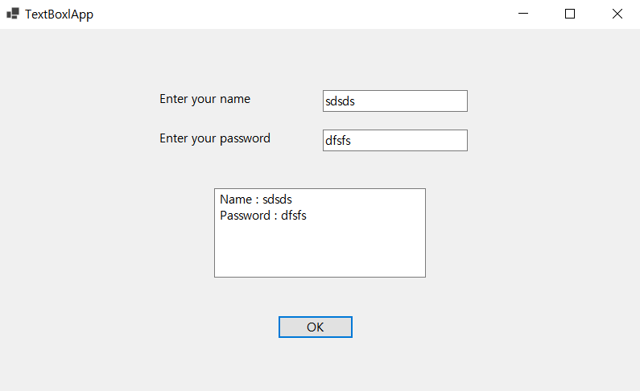
using System;
using System.Windows.Forms;
namespace TextBox
{
public partial class Form1 : Form
{
public Form1()
{
InitializeComponent();
}
private void textBox1_TextChanged(object sender, EventArgs e)
{
}
private void button1_Click(object sender, EventArgs e)
{
textBox3.Text = "Name : " + textBox1.Text +
"\r\nPassword : " + textBox2.Text;
}
}
}

Slide 6
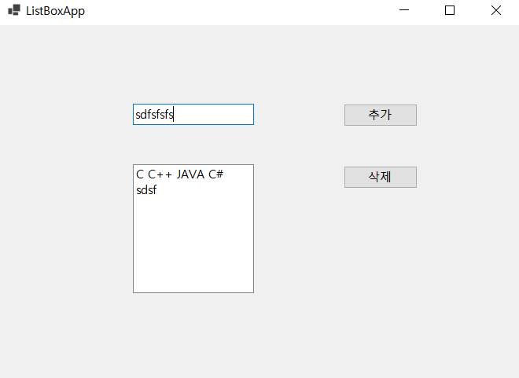
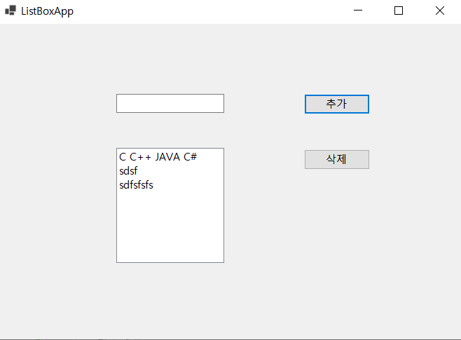
using System;
using System.Windows.Forms;
namespace TextBox
{
public partial class Form1 : Form
{
public Form1()
{
InitializeComponent();
}
private void button1_Click(object sender, EventArgs e)
{
if (textBox1.Text != "")
{ //리스트 상자 추가
listBox1.Items.Add(textBox1.Text);
textBox1.Text = "";
}
}
private void button2_Click(object sender, EventArgs e)
{
if (listBox1.SelectedIndex > -1)
listBox1.Items.RemoveAt(listBox1.SelectedIndex);
//리스트 상자의 선택된 항목을 제거
}
}
}

Slide 7
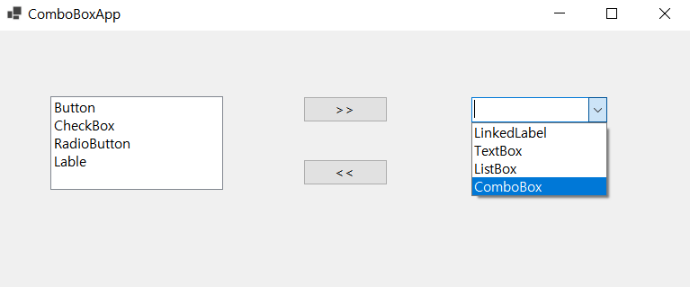
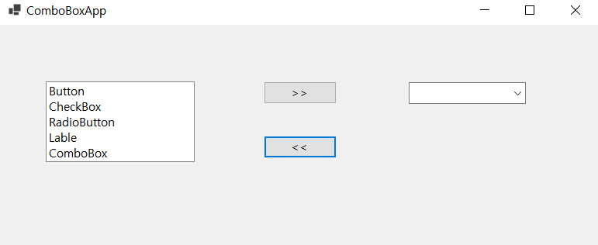
using System;
using System.Windows.Forms;
namespace TextBox
{
public partial class Form1 : Form
{
public Form1()
{
InitializeComponent();
}
private void button1_Click(object sender, EventArgs e)
{
if (listBox1.SelectedItem != null)
{
//리스트 상자의 선택 항목을 콤보 상자에 추가
comboBox1.Items.Add(listBox1.SelectedItem);
//리스트 상자에서 선택 항목을 삭제
listBox1.Items.Remove(listBox1.SelectedItem);
}
}
private void button2_Click(object sender, EventArgs e)
{
if (comboBox1.SelectedItem != null)
{
//리스트 상자의 선택 항목을 콤보 상자에 추가
listBox1.Items.Add(comboBox1.SelectedItem);
//리스트 상자의 선택 항목을 삭제
comboBox1.Items.Remove(comboBox1.SelectedItem);
}
}
}
}

Slide 8
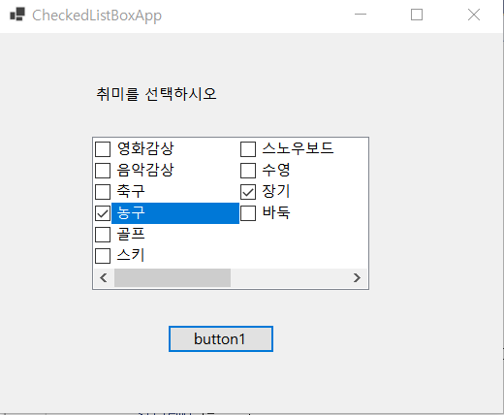
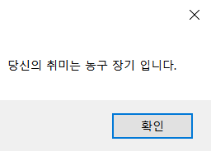
using System;
using System.Windows.Forms;
namespace TextBox
{
public partial class Form1 : Form
{
public Form1()
{
InitializeComponent();
}
private void button1_Click(object sender, EventArgs e)
{
string strTemp = "";
foreach (object obj in checkedListBox1.CheckedItems)
{
strTemp += obj.ToString();
strTemp += " ";
}
MessageBox.Show("당신의 취미는 " + strTemp + "입니다.");
}
}
}

Slide 9
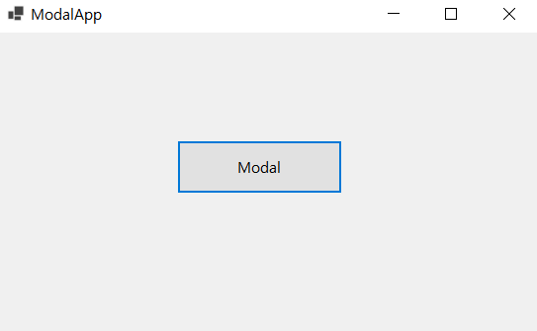
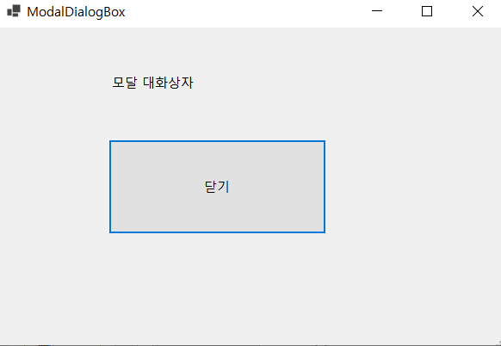
using System;
using System.Windows.Forms;
namespace TextBox
{
public partial class Form1 : Form
{
public Form1()
{
InitializeComponent();
}
private void button1_Click(object sender, EventArgs e)
{
Form2 form2 = new Form2();
form2.ShowDialog(); // form2를 모달 방식으로 띄운다.
}
}
}
using System;
using System.Windows.Forms;
namespace TextBox
{
public partial class Form2 : Form
{
public Form2()
{
InitializeComponent();
}
private void button1_Click(object sender, EventArgs e)
{
Close();
}
}
}

Slide 10
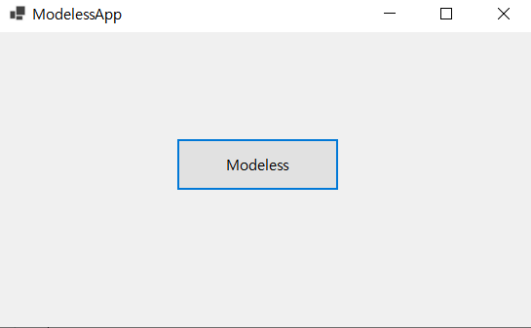
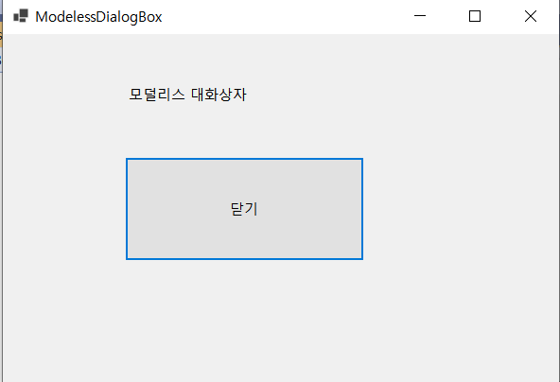
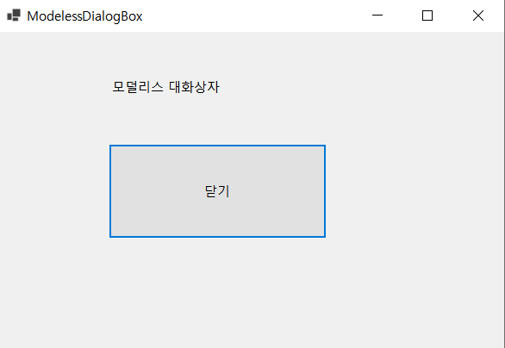
using System;
using System.Windows.Forms;
namespace TextBox
{
public partial class Form1 : Form
{
public Form1()
{
InitializeComponent();
}
private void button1_Click(object sender, EventArgs e)
{
Form2 form2 = new Form2();
form2.Show(); // form2를 모덜리스 방식으로 띄운다.
}
}
}
using System;
using System.Windows.Forms;
namespace TextBox
{
public partial class Form2 : Form
{
public Form2()
{
InitializeComponent();
}
private void button1_Click(object sender, EventArgs e)
{
Close();
}
}
}

Slide 11
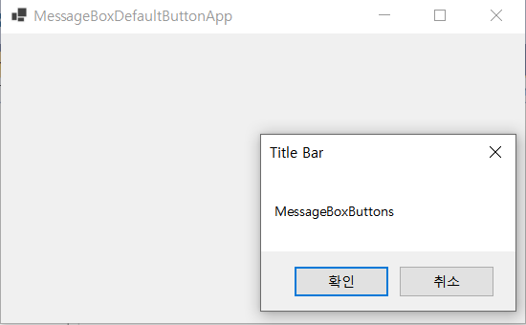
using System;
using System.Windows.Forms;
namespace TextBox
{
public partial class Form1 : Form
{
public Form1()
{
InitializeComponent();
}
private void Form1_Click(object sender, EventArgs e)
{
MessageBox.Show("MessageBoxButtons", "Title Bar",
MessageBoxButtons.OKCancel);
}
}
}

Slide 12
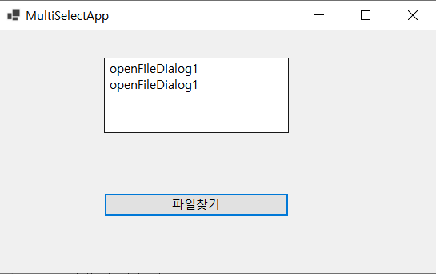
using System;
using System.Windows.Forms;
namespace TextBox
{
public partial class Form1 : Form
{
public Form1()
{
InitializeComponent();
}
private void button1_Click(object sender, EventArgs e)
{
openFileDialog1.InitialDirectory = @"C:\";
openFileDialog1.Filter
= "텍스트 파일(*.txt)|*.txt|모든 파일(*.*)|*.*";
openFileDialog1.FilterIndex = 1;
openFileDialog1.RestoreDirectory = true;
openFileDialog1.Multiselect = true;
openFileDialog1.ShowDialog();
foreach (string strTmp in openFileDialog1.FileNames)
{
textBox1.Text += strTmp;
textBox1.Text += "\r\n";
}
}
}
}

Slide 13
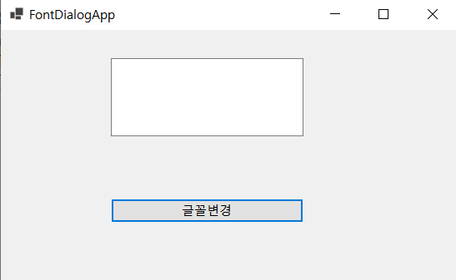
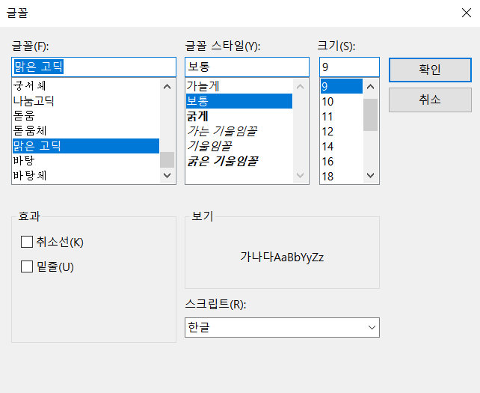
using System;
using System.Windows.Forms;
namespace TextBox
{
public partial class Form1 : Form
{
public Form1()
{
InitializeComponent();
}
private void button1_Click(object sender, EventArgs e)
{
fontDialog1.ShowDialog();
textBox1.Font = fontDialog1.Font;
textBox1.ForeColor = fontDialog1.Color;
}
}
}

Slide 14
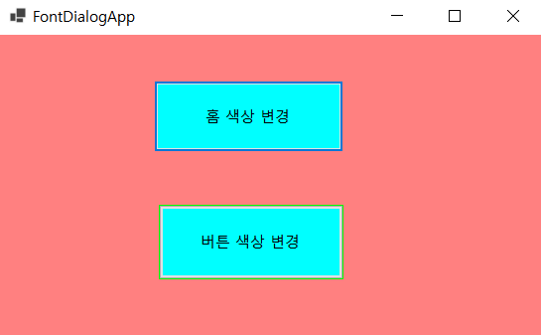
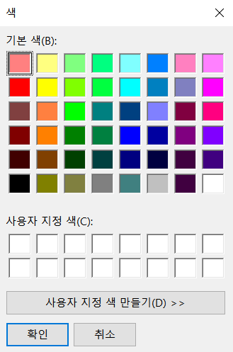
using System;
using System.Windows.Forms;
namespace TextBox
{
public partial class Form1 : Form
{
public Form1()
{
InitializeComponent();
}
private void button1_Click_1(object sender, EventArgs e)
{
colorDialog1.ShowDialog();
this.BackColor = colorDialog1.Color;
}
private void button2_Click(object sender, EventArgs e)
{
colorDialog1.ShowDialog();
button1.BackColor = colorDialog1.Color;
button2.BackColor = colorDialog1.Color;
}
}
}

Slide 15
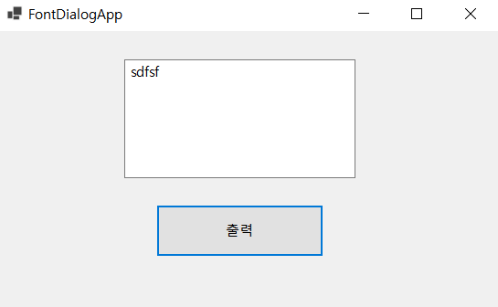
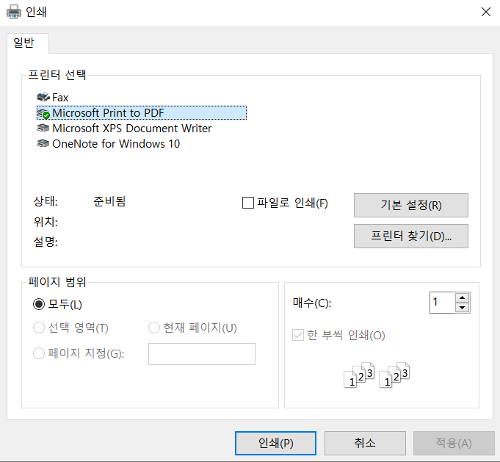
using System;
using System.Drawing.Printing;
using System.Windows.Forms;
namespace TextBox
{
public partial class Form1 : Form
{
public Form1()
{
InitializeComponent();
}
private void button1_Click(object sender, EventArgs e)
{
PrinterSettings printer = new PrinterSettings();
PrintDocument pd = new PrintDocument();
printDialog1.PrinterSettings = printer;
printDialog1.Document = pd;
printDialog1.ShowDialog();
}
}
}

Slide 16
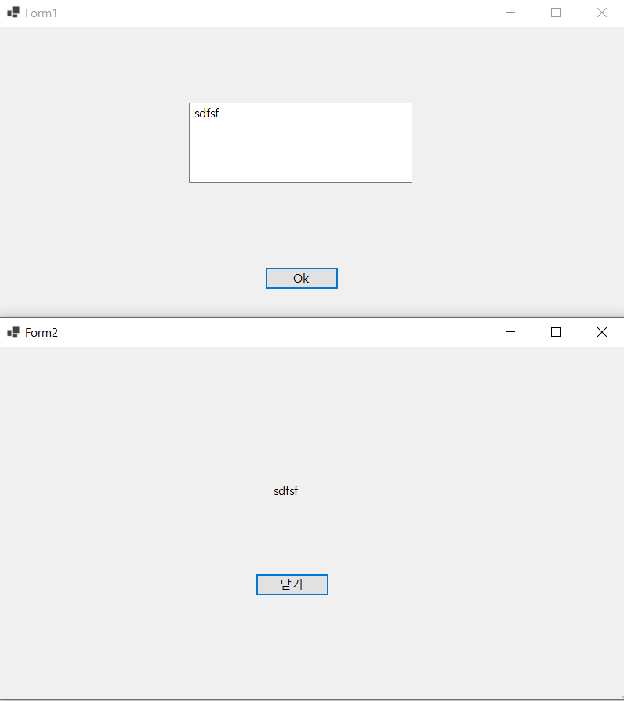

Slide 17
using System;
using System.Windows.Forms;
namespace CheckBoxSample
{
public partial class Form2 : Form
{
public Form2()
{
InitializeComponent();
}
private string Form2_value;
public string Passvalue
{
get { return this.Form2_value; }
set { this.Form2_value = value; } // 다른폼(Form1)에서 전달받은 값을 쓰기
}
private void label1_Click(object sender, EventArgs e)
{
}
private void Form2_Load(object sender, EventArgs e)
{
label2.Text = Passvalue;
}
private void label2_Click(object sender, EventArgs e)
{
}
private void button1_Click(object sender, EventArgs e)
{
Close();
}
}
}
using System;
using System.Windows.Forms;
namespace CheckBoxSample
{
public partial class Form1 : Form
{
public Form1()
{
InitializeComponent();
}
private void textBox1_TextChanged(object sender, EventArgs e)
{
}
private void button1_Click(object sender, EventArgs e)
{
if (textBox1.Text.Length == 0)
{
MessageBox.Show("값이 입력되지 않았습니다");
return;
}
Form2 frm2 = new Form2(); // Form2형 frm2 인스턴스화(객체 생성)
frm2.Passvalue = textBox1.Text; // 전달자(Passvalue)를 통해서 Form2 로 전달
frm2.ShowDialog();
}
}
}

